Slide 1
Model Unification for Object Tracking and Segmentation
Presenter: Pengyu Zhang
Date: Jul-07-2025

Slide 2
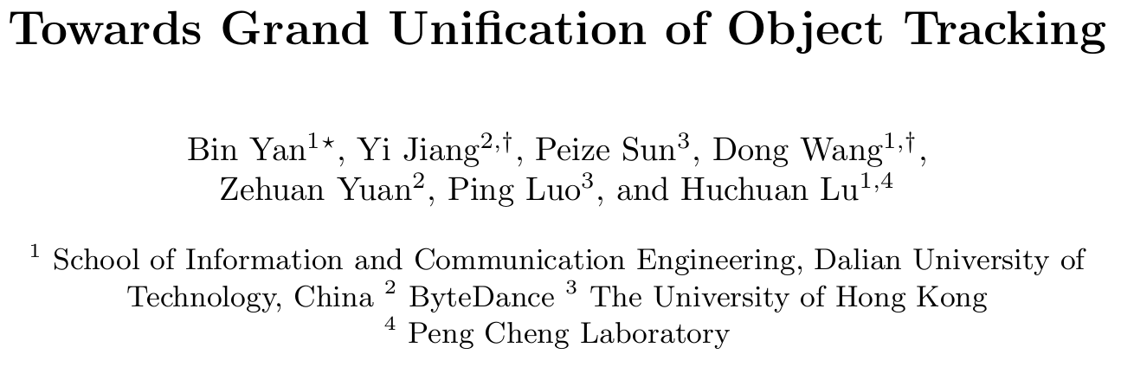
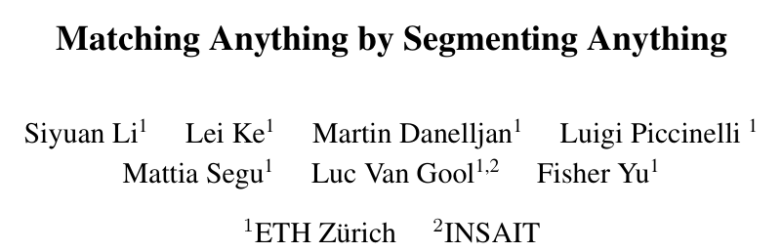
Outline
Yan et al. (Dalian University of Technology) Towards Grand Unification of Object Tracking. In ECCV 2022 (Oral).
Li et al. (ETH Zürich) Matching Anything by Segmenting Anything. In CVPR 2024 (Highlight).

Slide 3
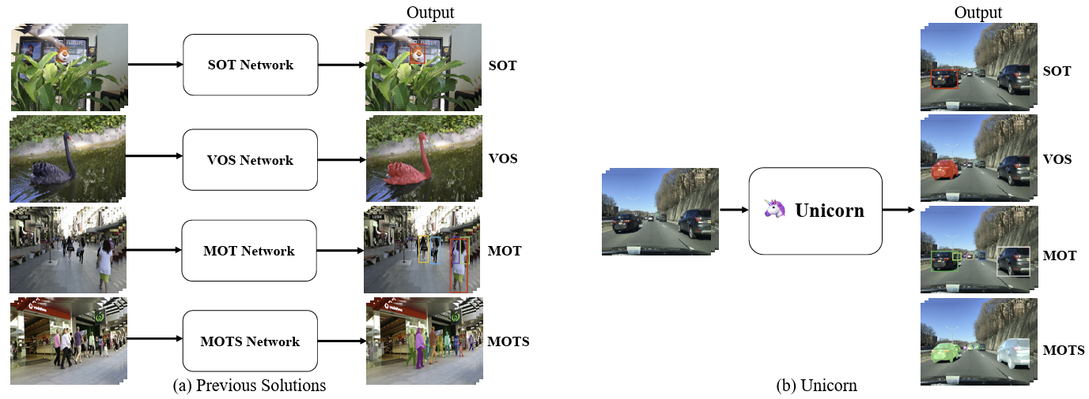
Motivation
Previous trackers are developed for only one of or part of the sub-tasks.
Various characteristics of tracked objects: SOT is a class-agnostic model, which tracks a specific target. MOT tracks tens even hundreds of instances of specific categories.
Different types of correspondence: SOT require distinguishing the target from the background. MOT needs to match the currently detected objects with previous trajectories.
Different inputs: SOT methods only take a small search region as the input, while MOT algorithms usually take the high-resolution full image as the input for detecting instances as completely as possible.
Handling four tasks in one model
Bin Yan, Yi Jiang, Peize Sun, et al. Towards Grand Unification of Object Tracking. In ECCV 2022 (oral).

Slide 4
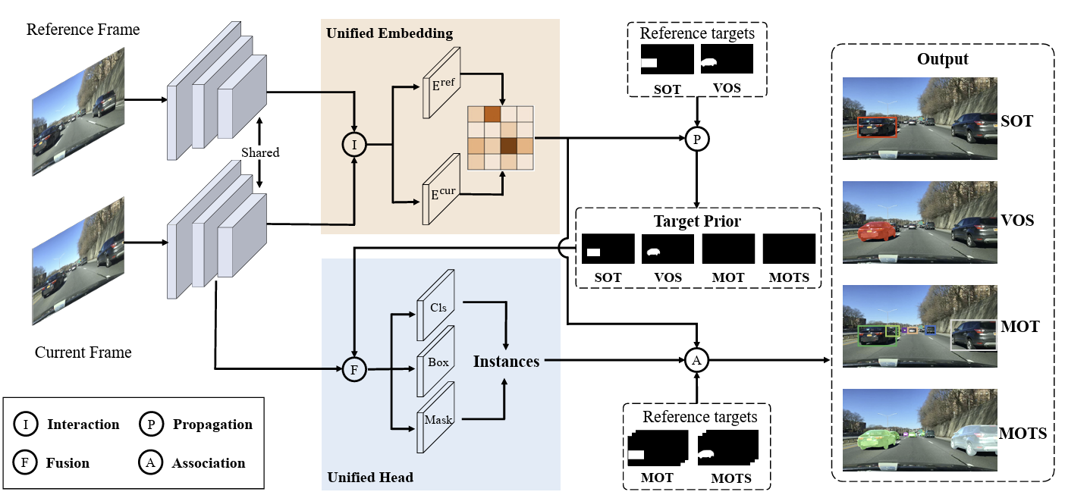
Framework
Unified Input: extracts Multi-scale features using shared backbones, which takes the whole images as inputs.
Unified Embedding: models the temporal relationship between adjacent frames.
Unified Head: utilizes a detection head generate object information (mask, box and class).
Bin Yan, Yi Jiang, Peize Sun, et al. Towards Grand Unification of Object Tracking. In ECCV 2022 (oral).

Slide 5
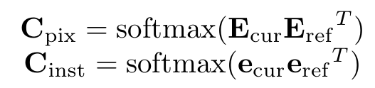
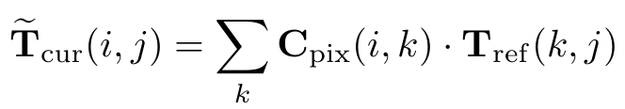
Framework
Unified Embedding: The features are firstly interacted with deformable attention and calculate the pixel-level and instance-level correspondence map to model the target variation between frames.
Step 1
Pixel-level correspondence
Instance-level correspondence
To indicate the tracked target for SOT and VOS, a target prior is obtained via the previous target location.
Step 2
Bin Yan, Yi Jiang, Peize Sun, et al. Towards Grand Unification of Object Tracking. In ECCV 2022 (oral).

Slide 6
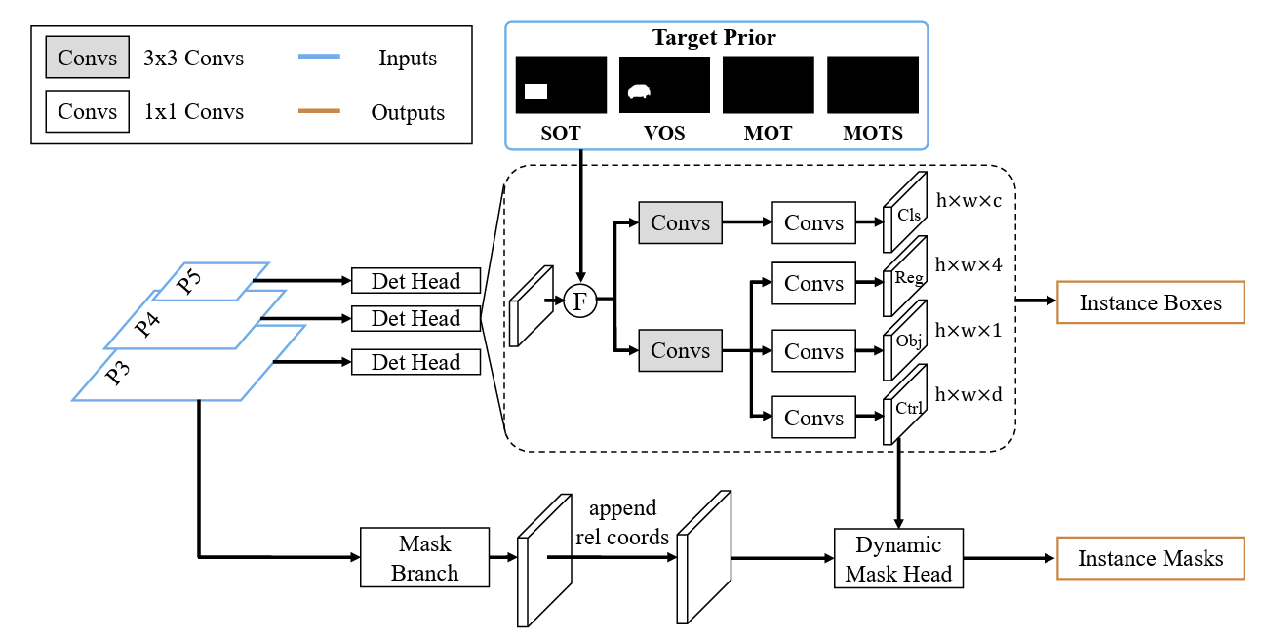
Framework
Unified Head: Detection^{[1]} and segmentation^{[2]} heads is utilized to generate instance information (bounding box, mask and class).
The multi-scale features with target prior are fused for detection.
For SOT and VOS, the prior indicates the tracked target
For MOT and MOTS, no additional prior are used to detect the whole
Image.
Finally, the association method^{[3]} is used for target association.
Bin Yan, Yi Jiang, Peize Sun, et al. Towards Grand Unification of Object Tracking. In ECCV 2022 (oral).
[1] YOLOX: Exceeding yolo series in 2021. In Arxiv 2021.
[2] Conditional convolutions for instance segmentation. In ECCV 2020.
[3] ByteTrack: Multi-Object Tracking by Associating Every Detection Box. In ECCV 2022.

Slide 7
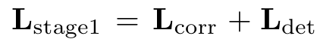
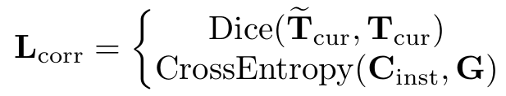
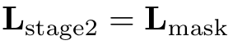
Training
Two stage training strategy is utilized.
Bounding box level training: train the model with SOT and MOT data. Both correspondence map and detection
results are suerpvised via
Mask level training: The model is trained with VOS and MOTS data. Only mask head is trained.
For SOT
For MOT

Slide 8
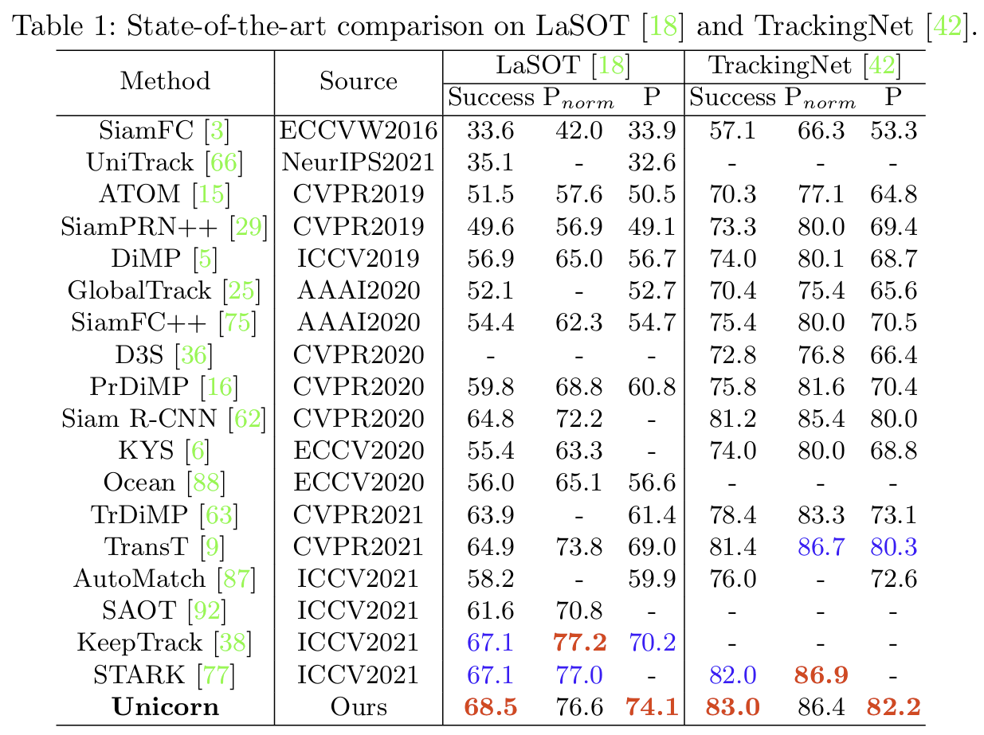
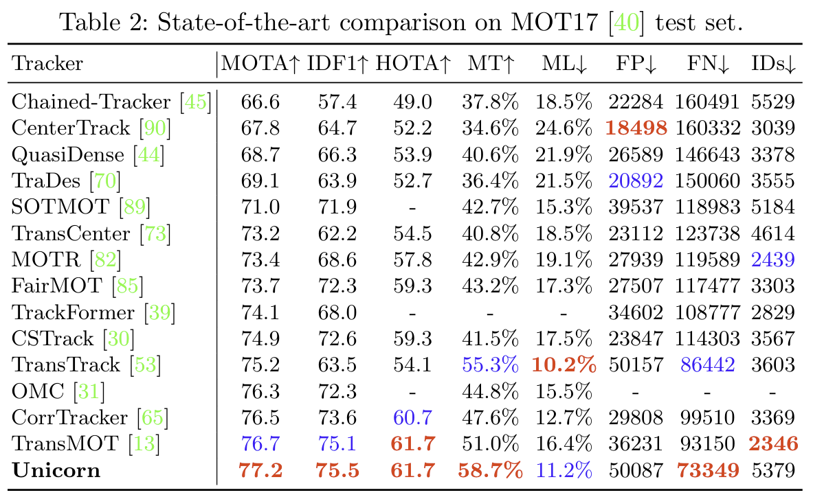
Experiments
SOT results
MOT results

Slide 9
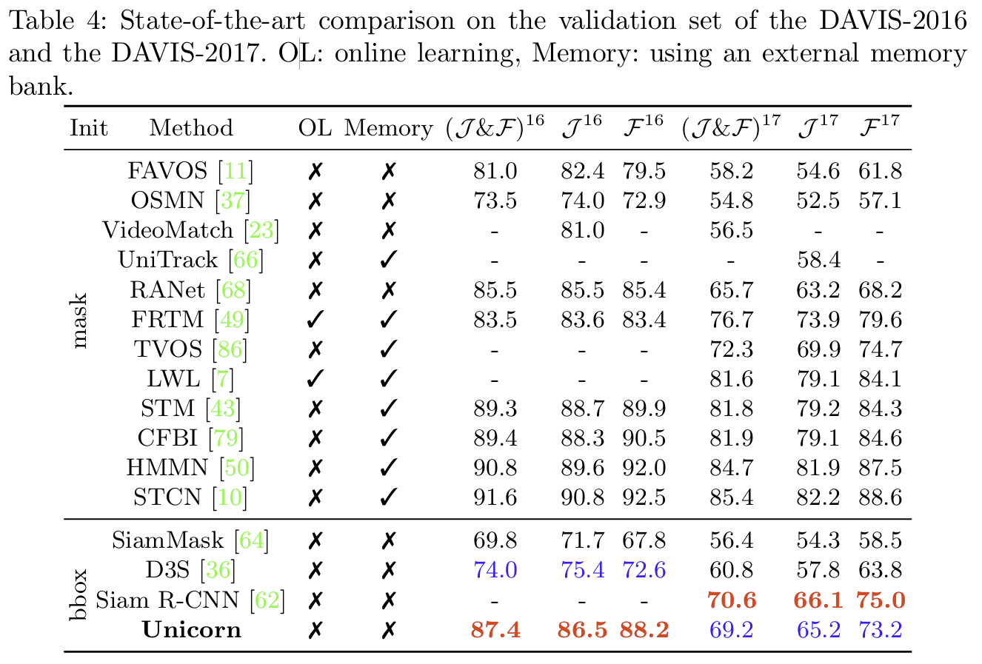
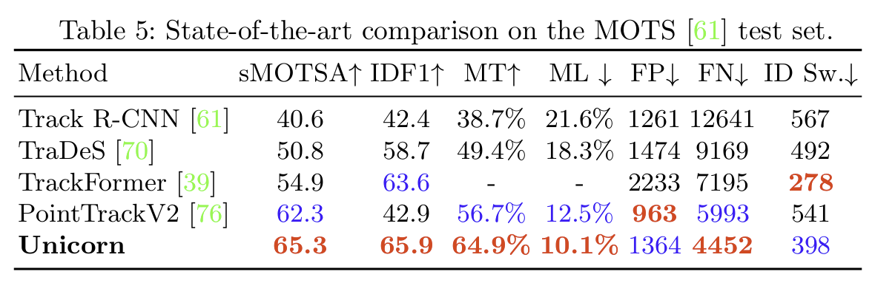
Experiments
VOS results
MOTS results

Slide 10
Summary
Conclusion
This is the first work to discuss the model unification for object tracking, providing a framework to handle
four tasks.
The framework can be decoupled by ”feature extraction+ temporal modeling + target localization”.
Limitations
The model ignores a memory-aware module, which cannot model long-term correspondence.
The target prior for SOT and VOS only indicate the target position in the first frame.
The model mainly borrows the structure from YOLOX, which cannot build a power target representation.

Slide 11
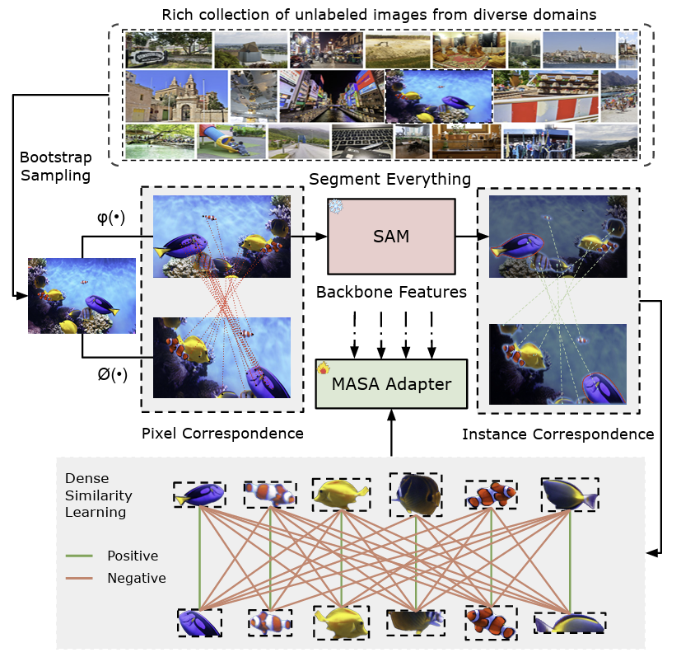
Motivation
Previous works learns effective object association with a significant amount of annotated data.
Leveraging the power from foundation models (e.g., SAM), MASA learns both pixel and instance-level correspondences through exhaustive unlabeled data with transformations.
Siyuan Li, Lei Ke, Martin Danelljan, et al. Matching Anything by Segmenting Anything. In CVPR 2024 (Highlight).

Slide 12
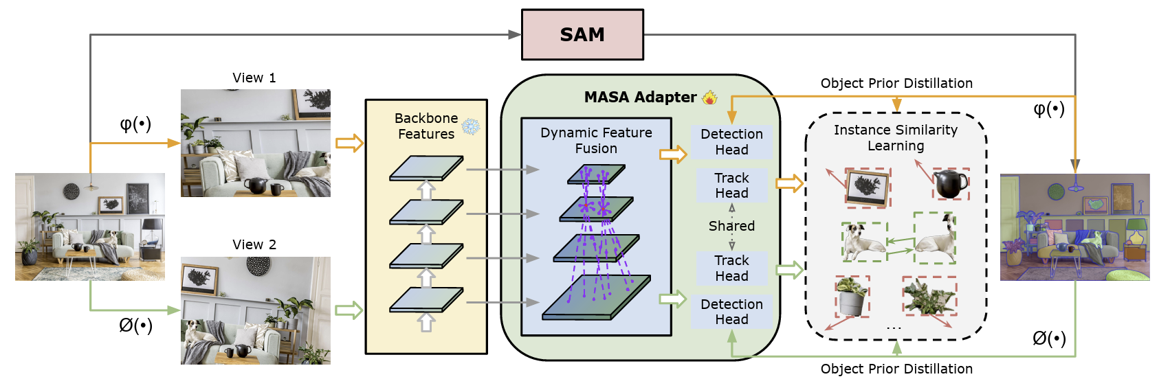
Training Pipeline
This paper propose a self-supervised learning paradigm to learn the instance correspondence with unlabeled data.
Image processing: Two Transformation process is conducted in one image to generate image in different views.
MASA adapter: Aggregates multi-scale feature using deformable conv and generate results via Detection/Tracking head.
Instance generation: Instance proposal is generated via SAM and processed with the same transformation.
Siyuan Li, Lei Ke, Martin Danelljan, et al. Matching Anything by Segmenting Anything. In CVPR 2024 (Highlight).

Slide 13
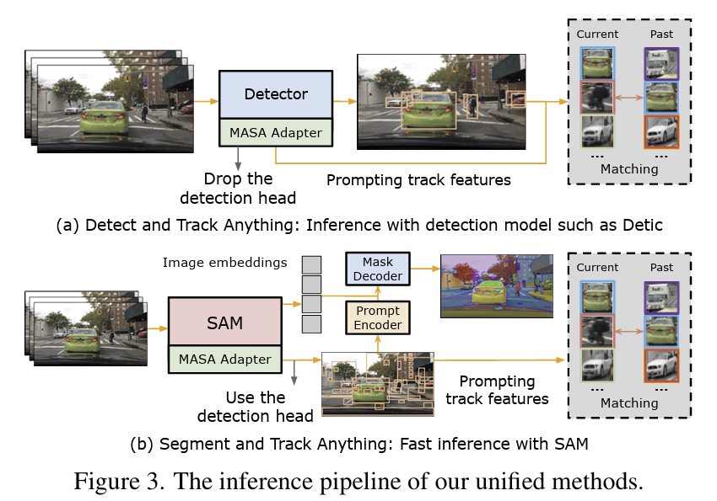
Inference Pipeline
For MOT tasks, MASA adapter serves as a tracker, which associates the detection results with previous trajectories.
For MOTS tasks, detection head is kept to prompt the mask decoder from SAM and MASA adapter.
Siyuan Li, Lei Ke, Martin Danelljan, et al. Matching Anything by Segmenting Anything. In CVPR 2024 (Highlight).

Slide 14
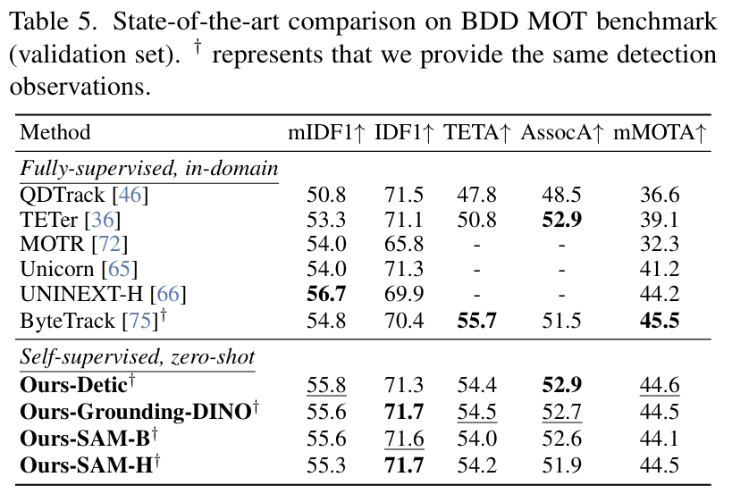
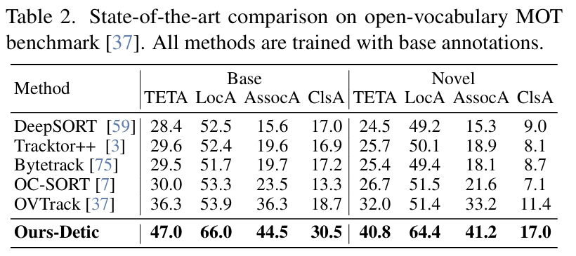
Experiments
Traditional MOT Results
Open-vocabulary MOT Results
MASA Adapter can be eqiupped with various foundation models, such as Detic, Grounding-Dino and SAM, etc
Siyuan Li, Lei Ke, Martin Danelljan, et al. Matching Anything by Segmenting Anything. In CVPR 2024 (Highlight).

Slide 15
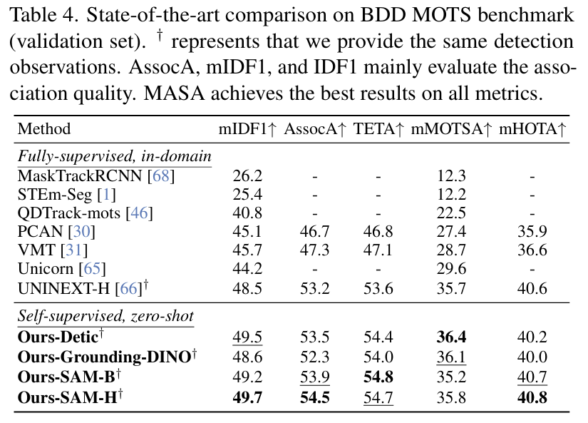

Experiments
MOTS Results
Demo Video
With the power of foundation models, MASA adapter are robust with distractors and tiny object.
Siyuan Li, Lei Ke, Martin Danelljan, et al. Matching Anything by Segmenting Anything. In CVPR 2024 (Highlight).

Slide 16
Thanks for Listening!
Q&A

